Slide 1
LOGISTIC OPTIMIZATION FOR DELIVERY ROUTES AMAZON
A MySQL PROJECT
SUBMITTED BY,
NAME: RIYA THAKUR P
COURSE: DATA SCIENCE
DATE: 09/03/2026

Slide 2
Project Objective
TO Build a SQL-driven Logistics analytics system to analyze delays, optimize routes, and enhance shipment efficiency by leveraging queries, aggregations. The project aims to answer key business questions, uncover inefficiencies, and recommend actionable improvements based on data analysis.

Slide 3
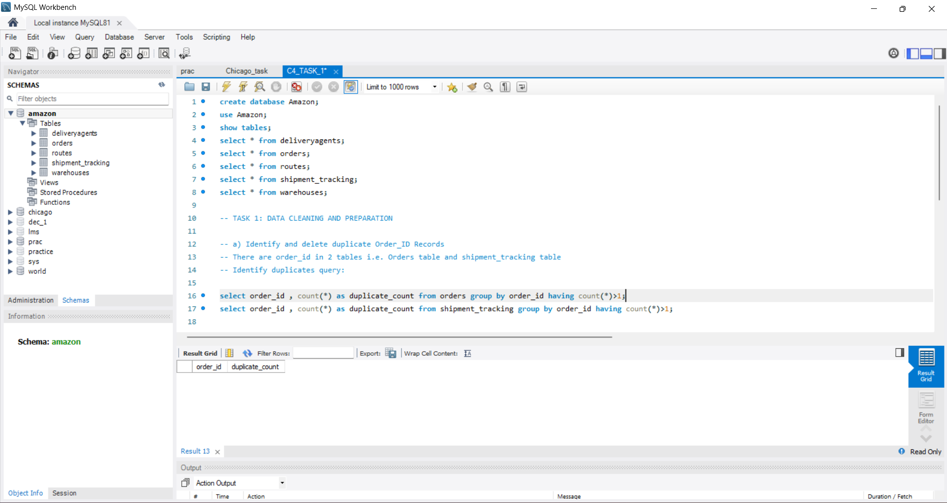
TASK 1: DATA CLEANING & PREPARATION
IDENTIFY AND DELETE DUPLICATE Order_id records

Slide 4
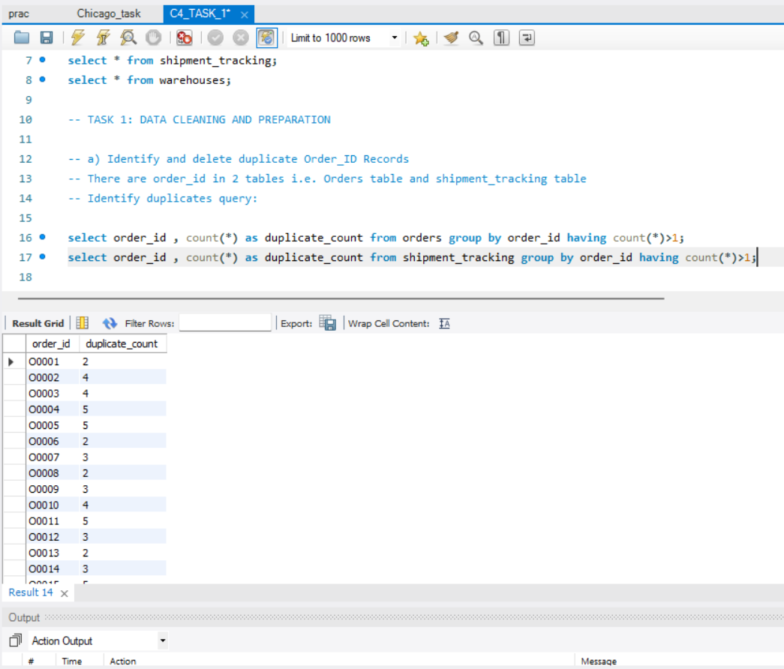
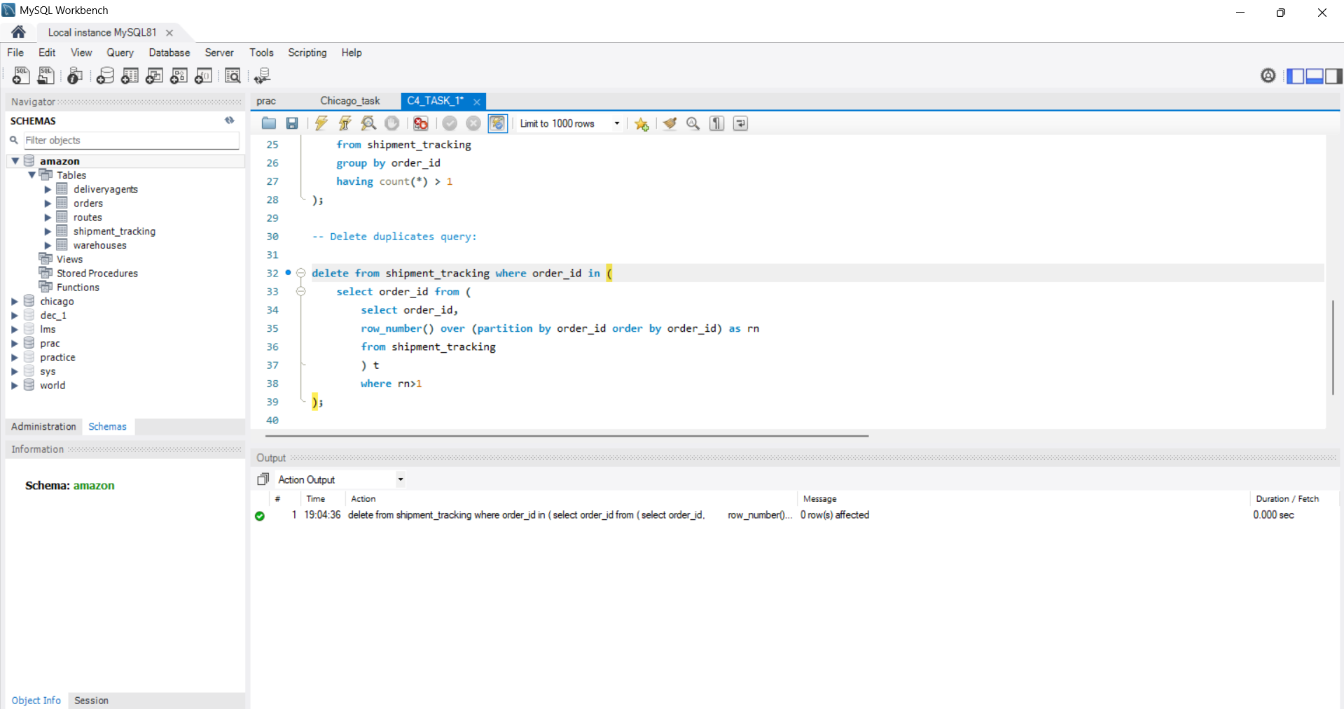
The shipment_tracking table has duplicate values
DELETE DUPLICATES QUERY

Slide 5
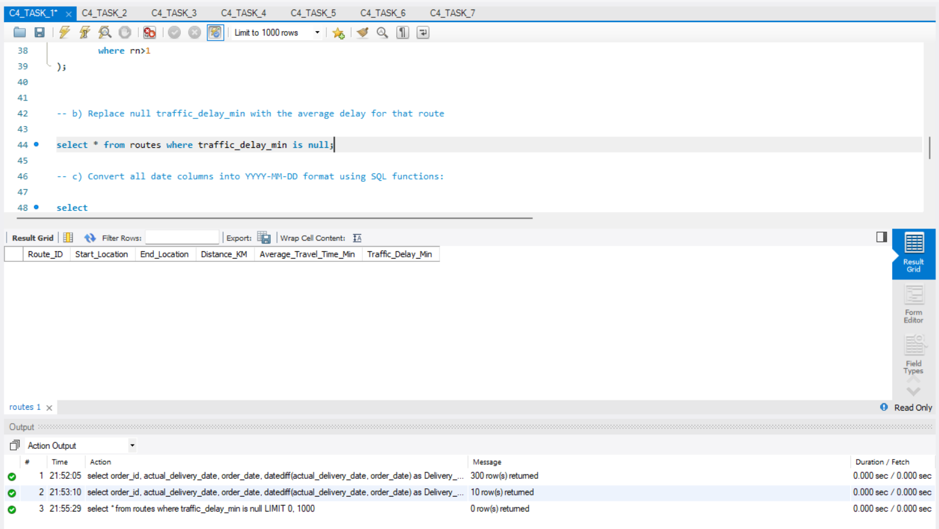
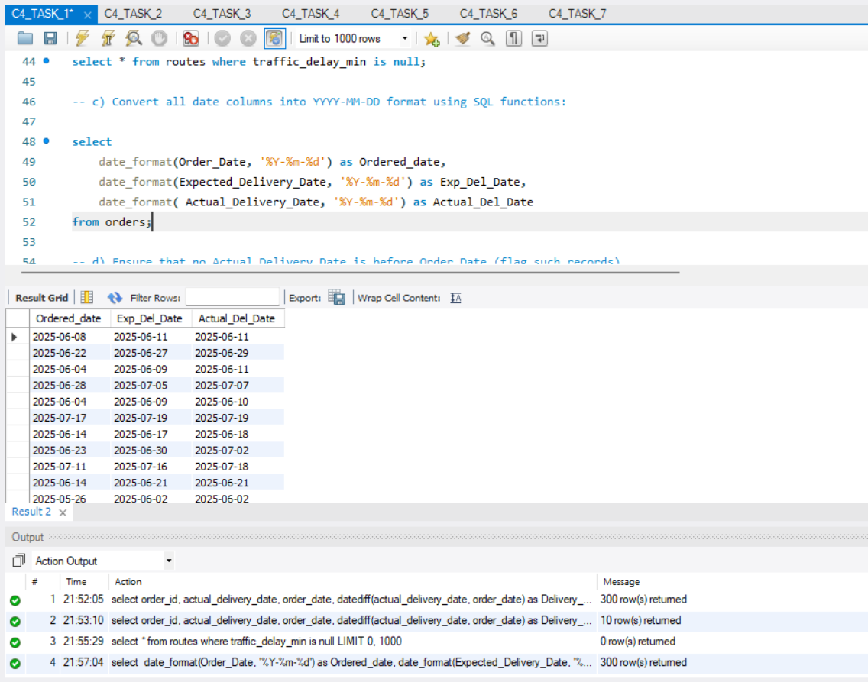
1. c) Convert all date columns into YYYY-MM-DD format using SQL functions.
1. b) Replace null traffic_delay_min with the average delay for that route

Slide 6
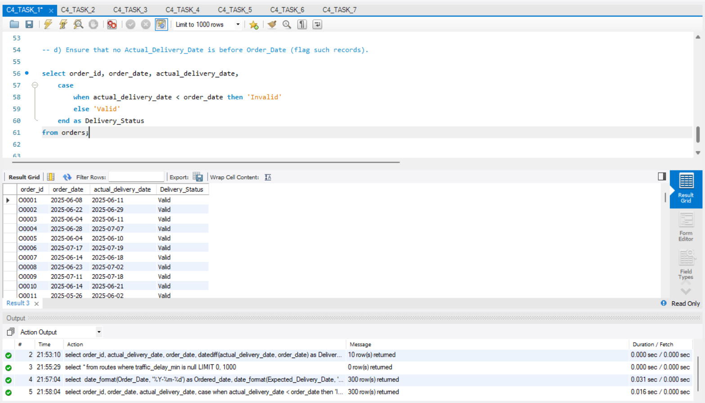
1. d) Ensure that no actual_delivery_date is before order_date (flag such records).

Slide 7
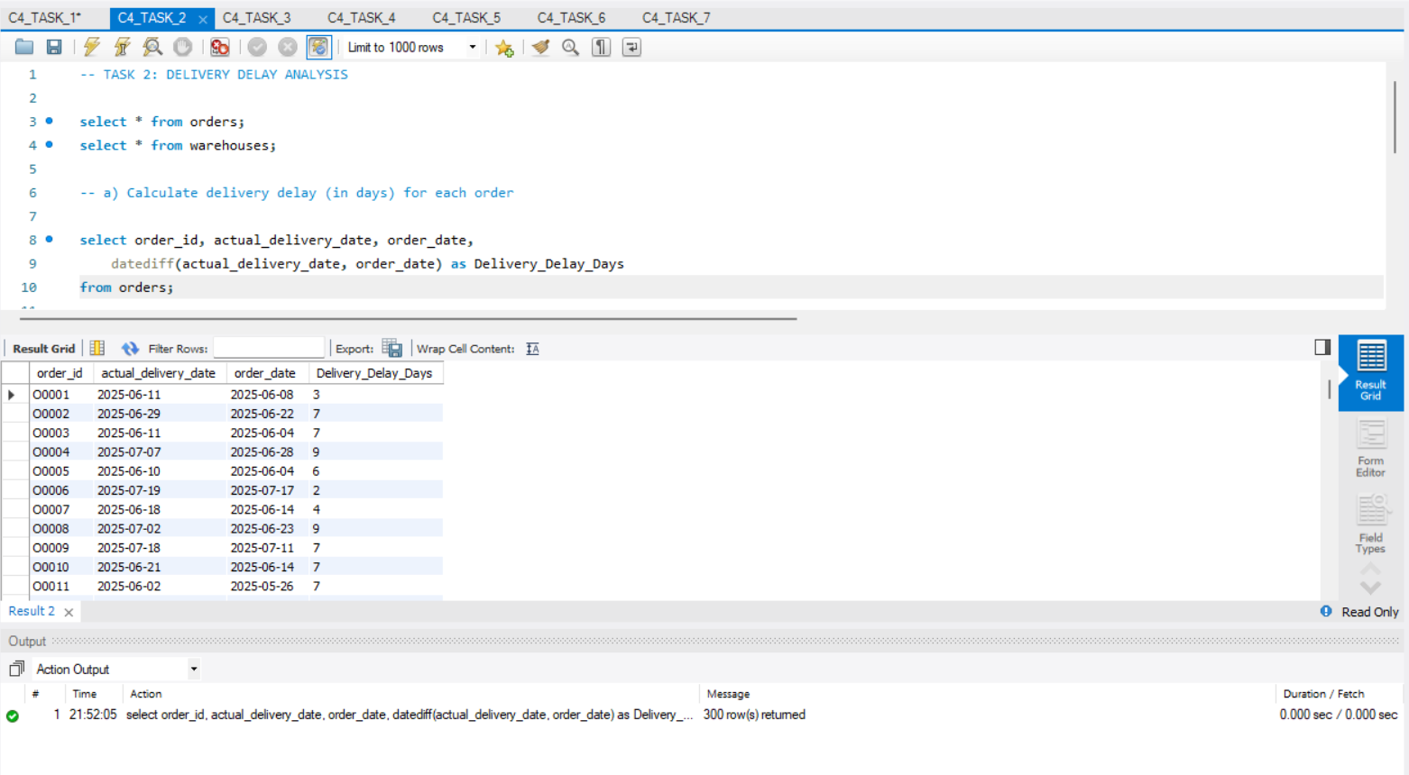
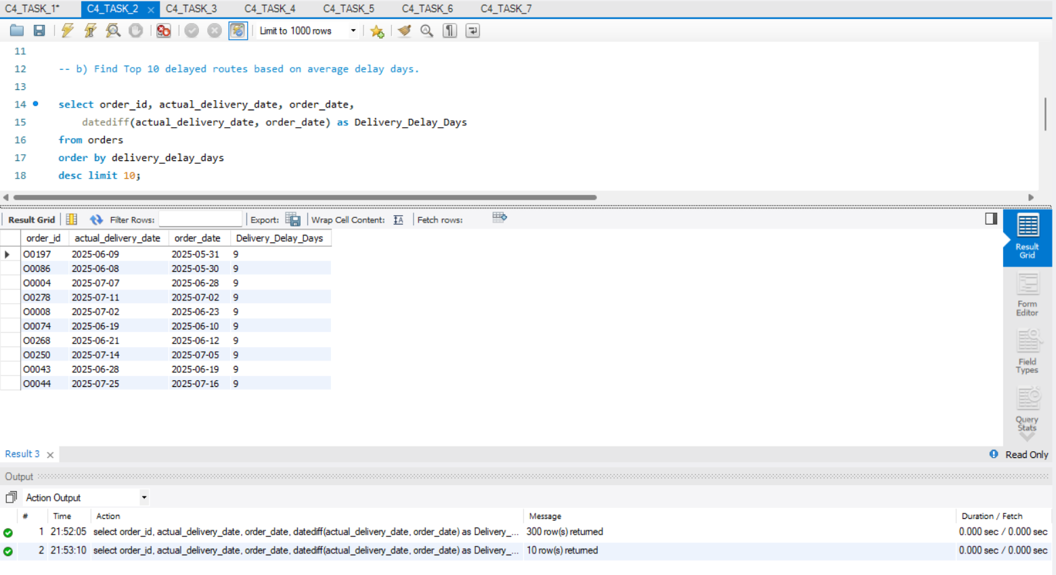
Task 2: delivery delay analysis
2. a) Calculate delivery delay (in days) for each order
2. b) Find Top 10 delayed routes based on average delay days.

Slide 8
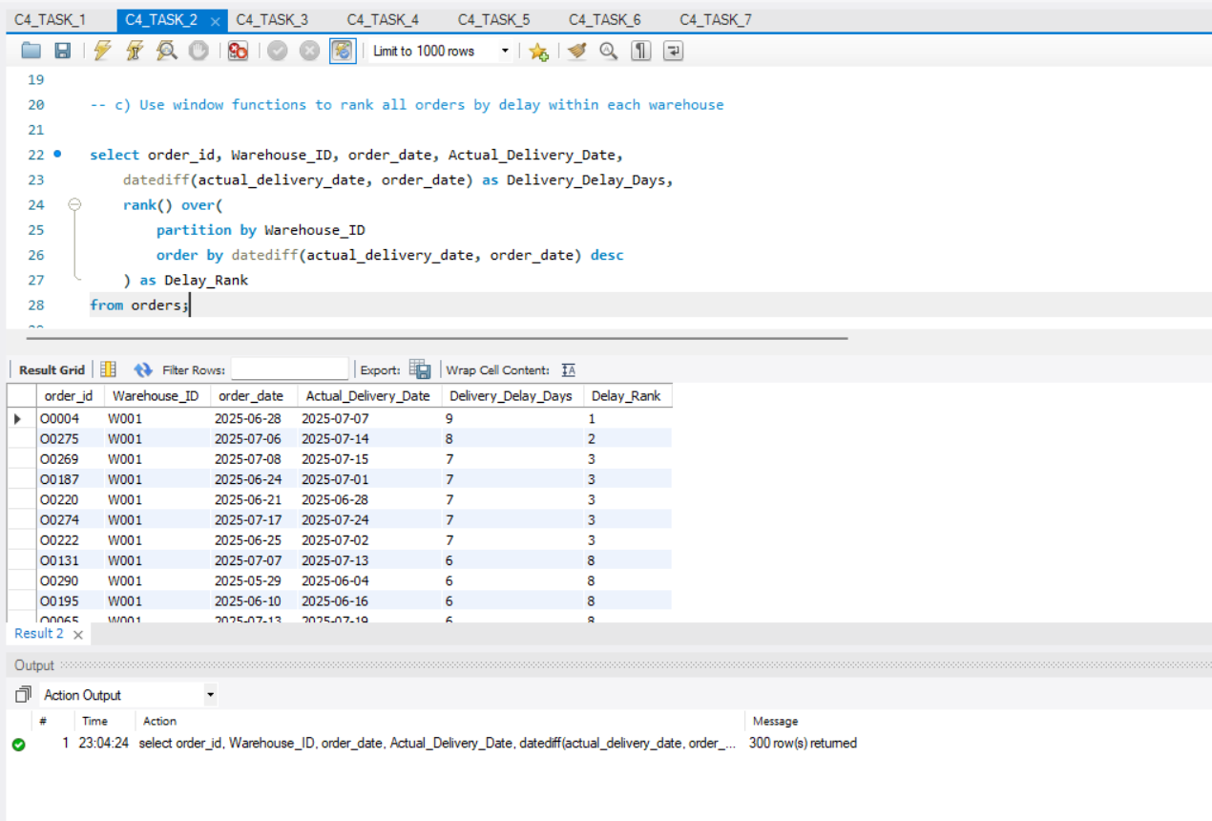
2. c) Use window functions to rank all orders by delay within each warehouse.

Slide 9
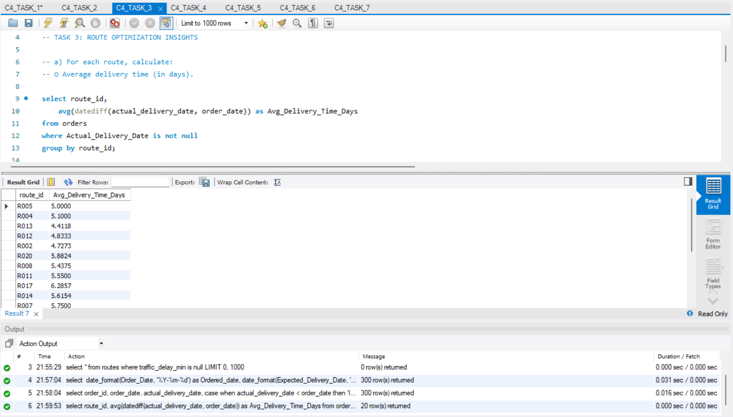
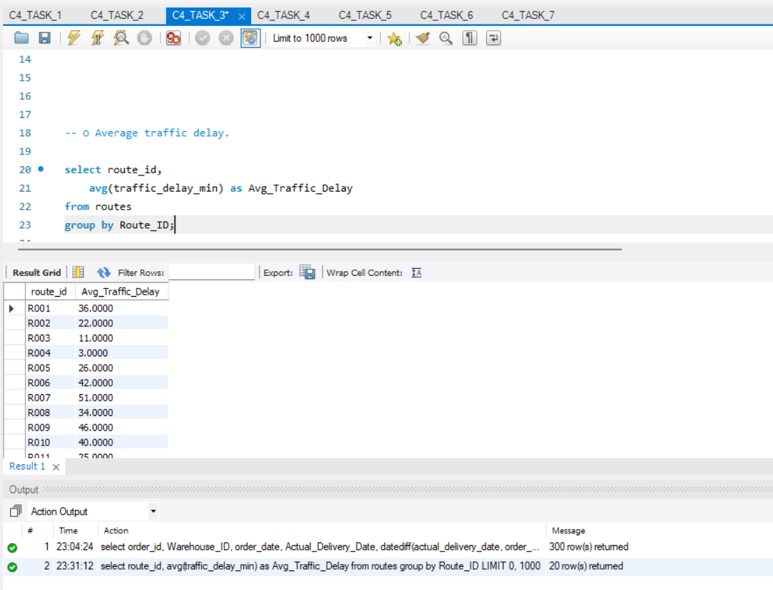
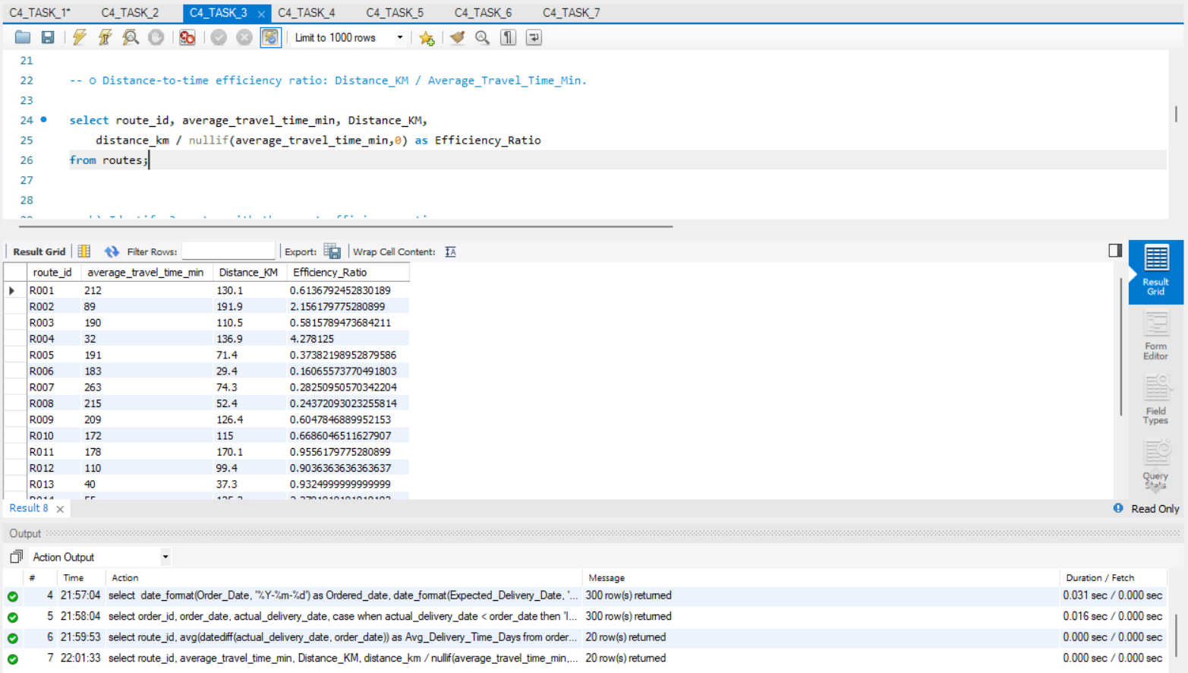
Task 3: route optimization insights
3. a) For each route, calculate: Average delivery time (in days).
3. A) For each route, calculate: Average traffic delay.
3. A) For each route, calculate: Distance-to-time efficiency ratio: distance_km / average_travel_time_min

Slide 10
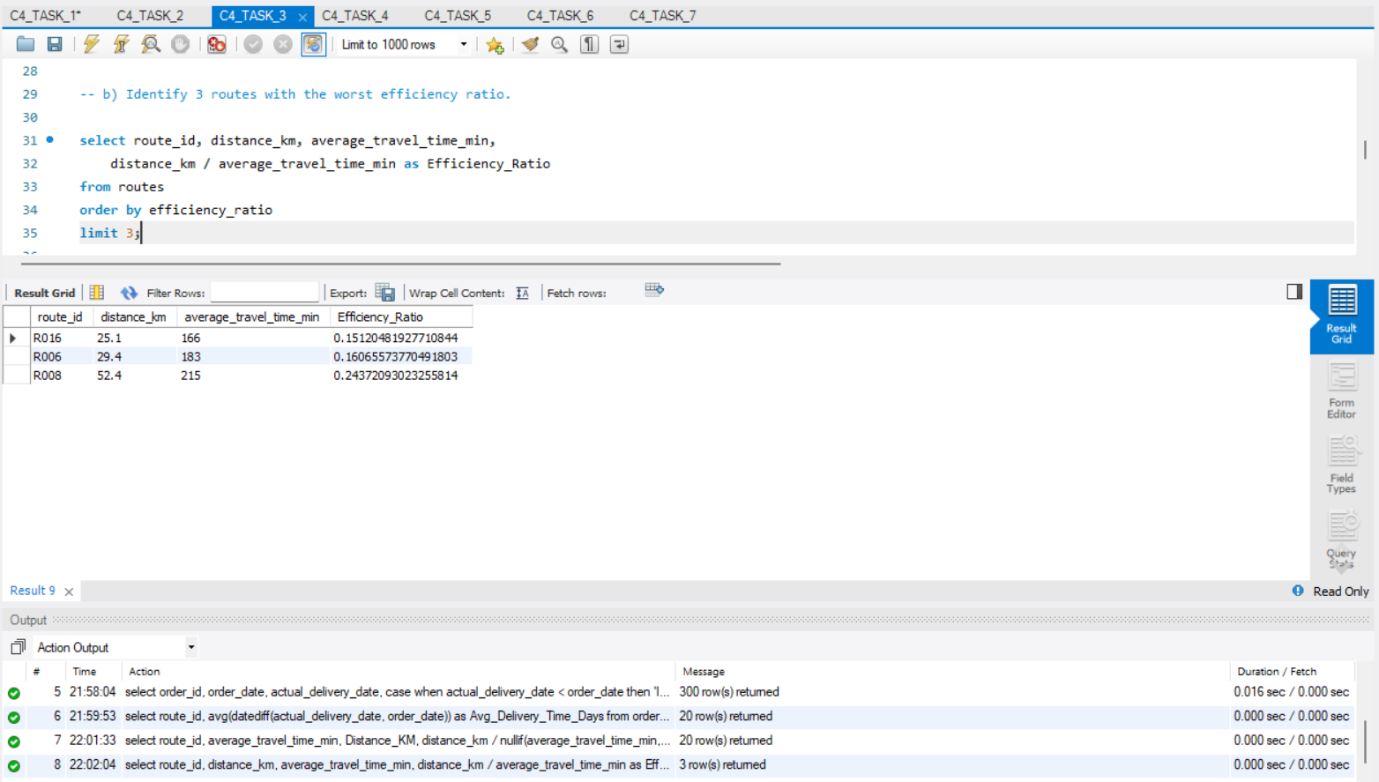
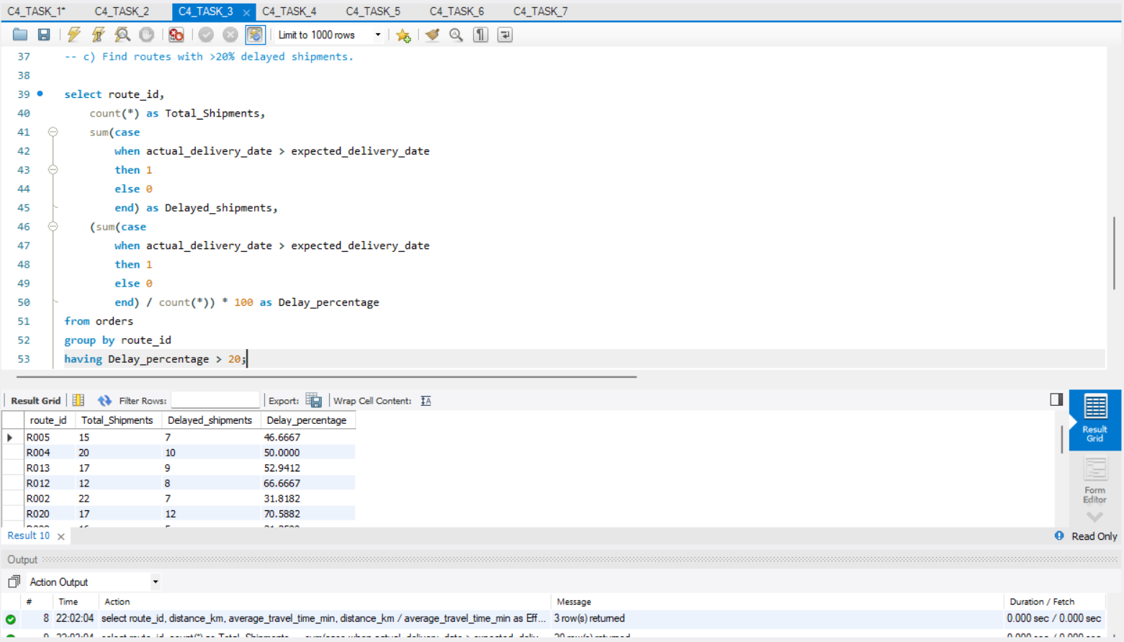
3. c) Find routes with >20% delayed shipments.
3. b) Identify 3 routes with the worst efficiency ratio.

Slide 11
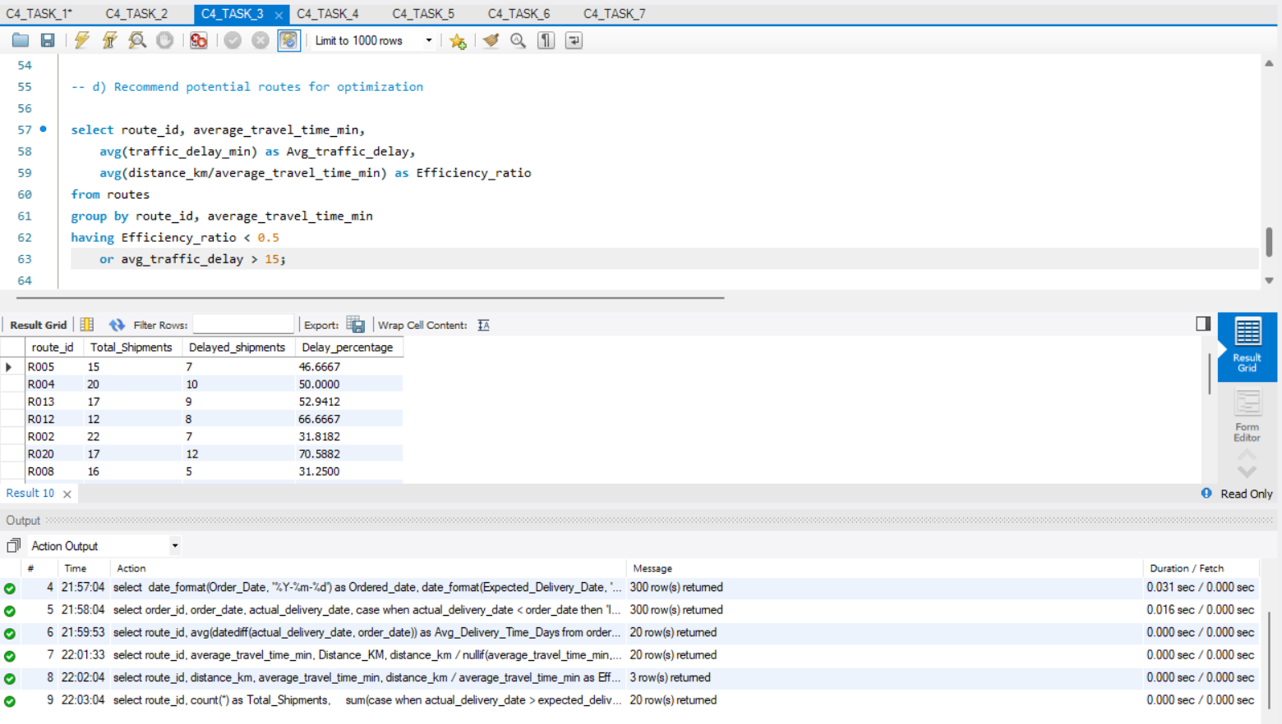
3. d) Recommend potential routes for optimization.

Slide 12
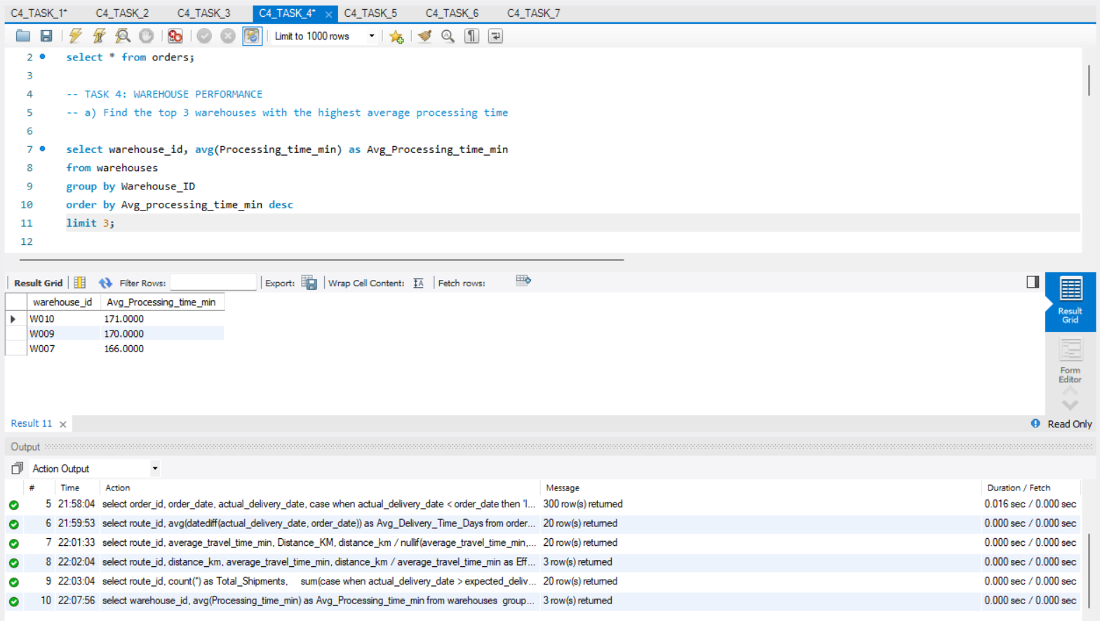
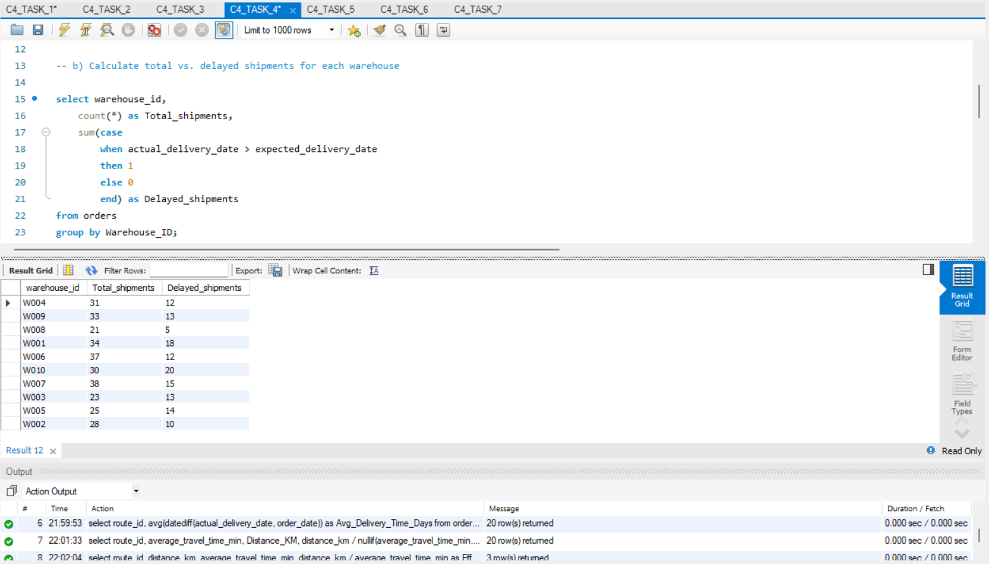
Task 4: Warehouse Performance
4. a) Find the top 3 warehouses with the highest average processing time
4. b) Calculate total vs. delayed shipments for each warehouse

Slide 13
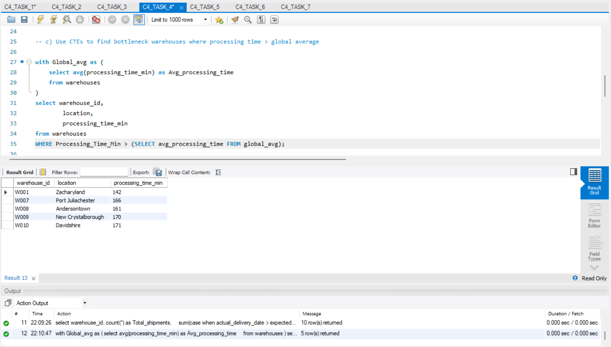
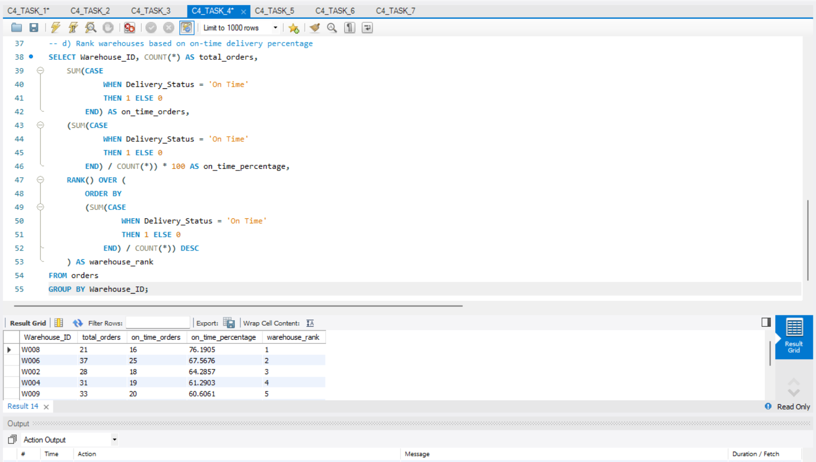
4. d) Rank warehouses based on on-time delivery percentage.
4. c) Use CTEs to find bottleneck warehouses where processing time > global average.

Slide 14
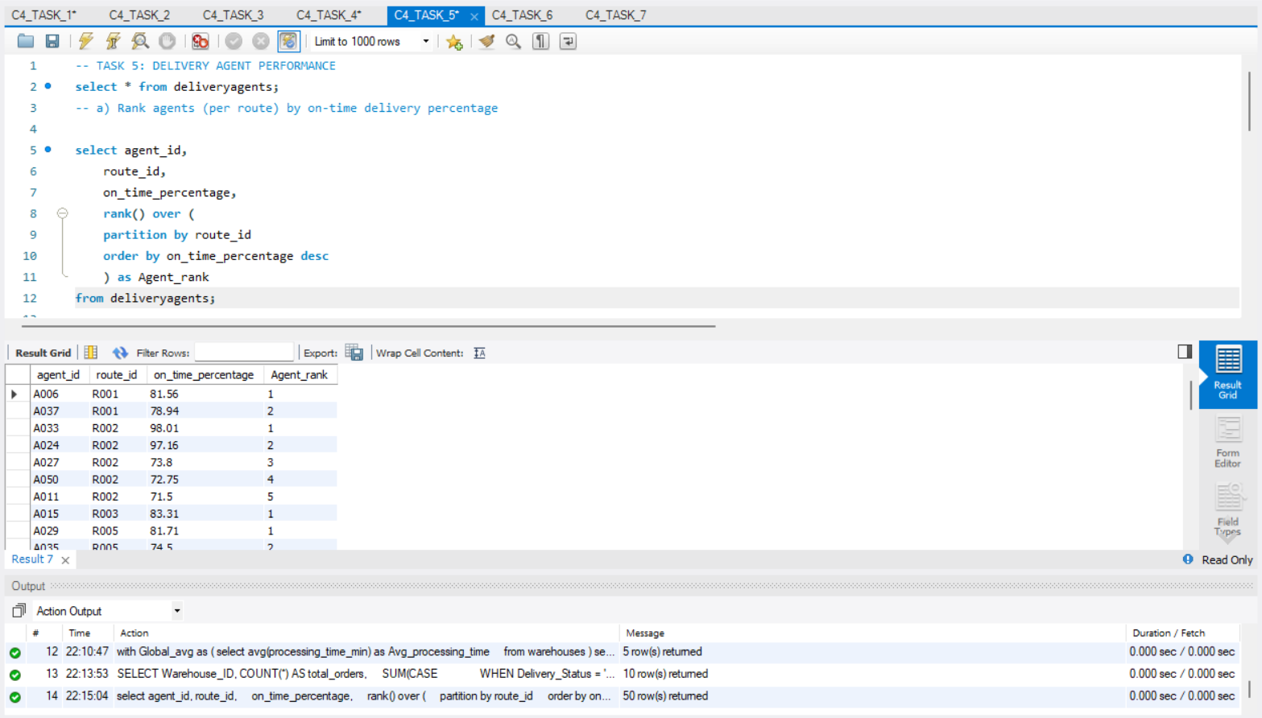
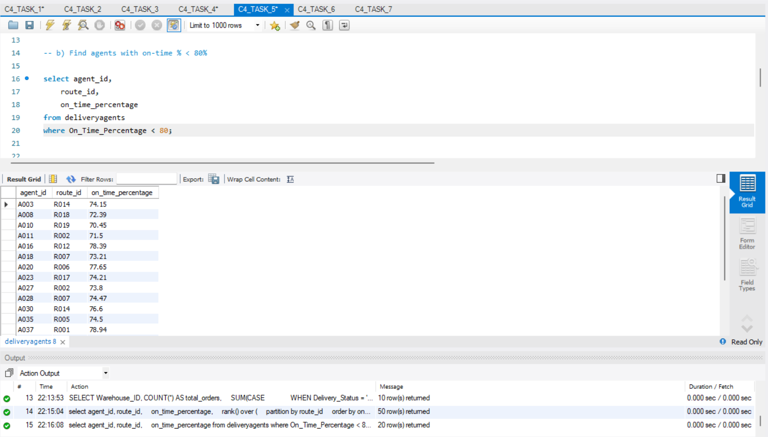
Task 5: Delivery Agent Performance
5. a) Rank agents (per route) by on-time delivery percentage
5. b) Find agents with on-time % < 80%

Slide 15
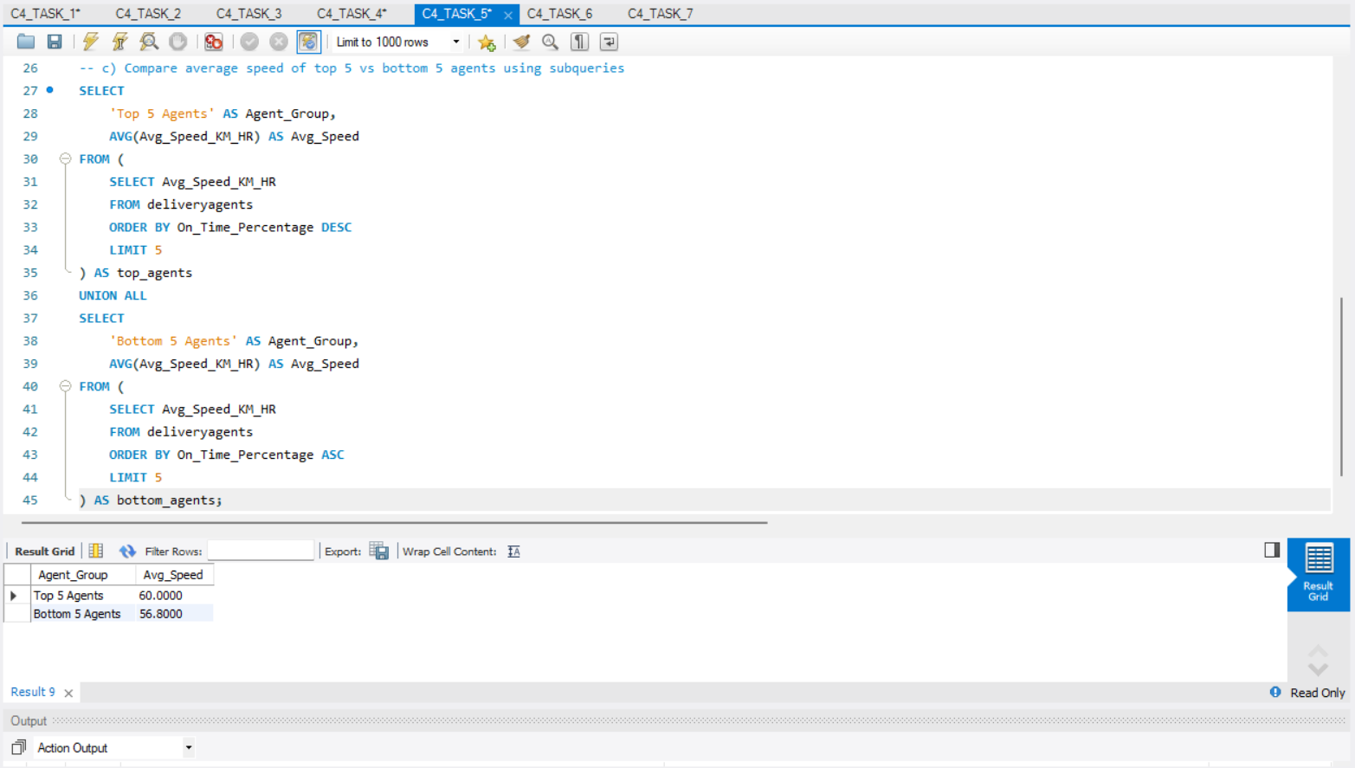
5. c) Compare average speed of top 5 vs bottom 5 agents using subqueries

Slide 16
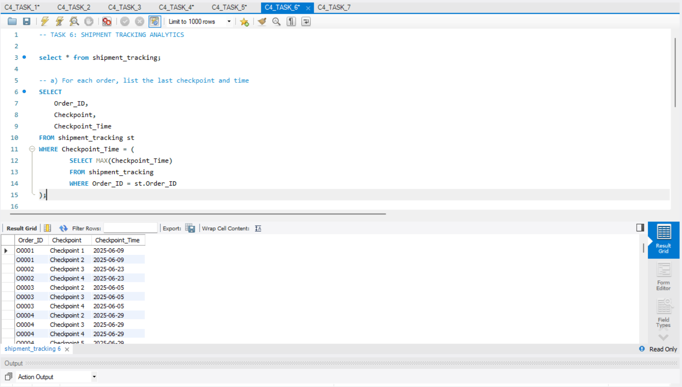
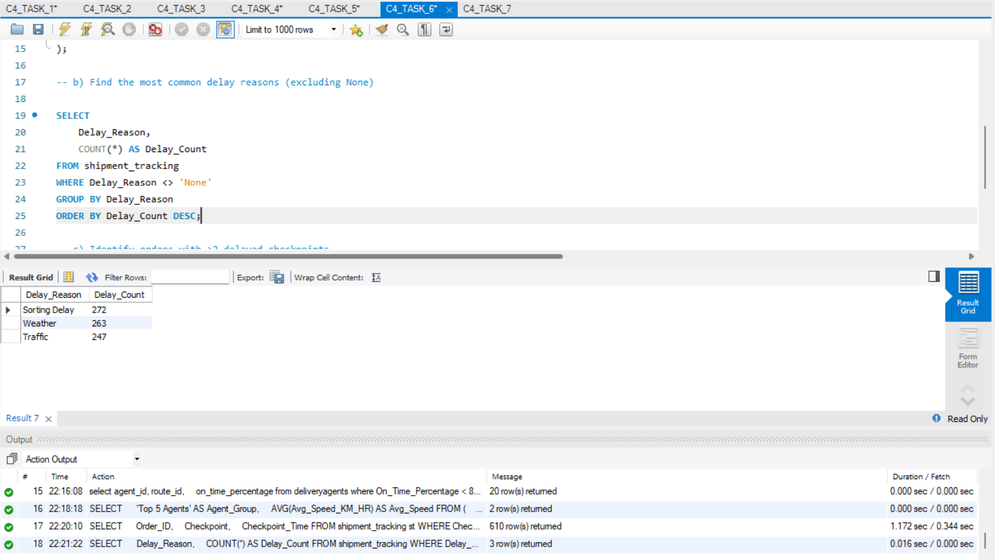
6. b) Find the most common delay reasons (excluding None)
Task 6: Shipment Tracking Analytics
6. a) For each order, list the last checkpoint and time

Slide 17
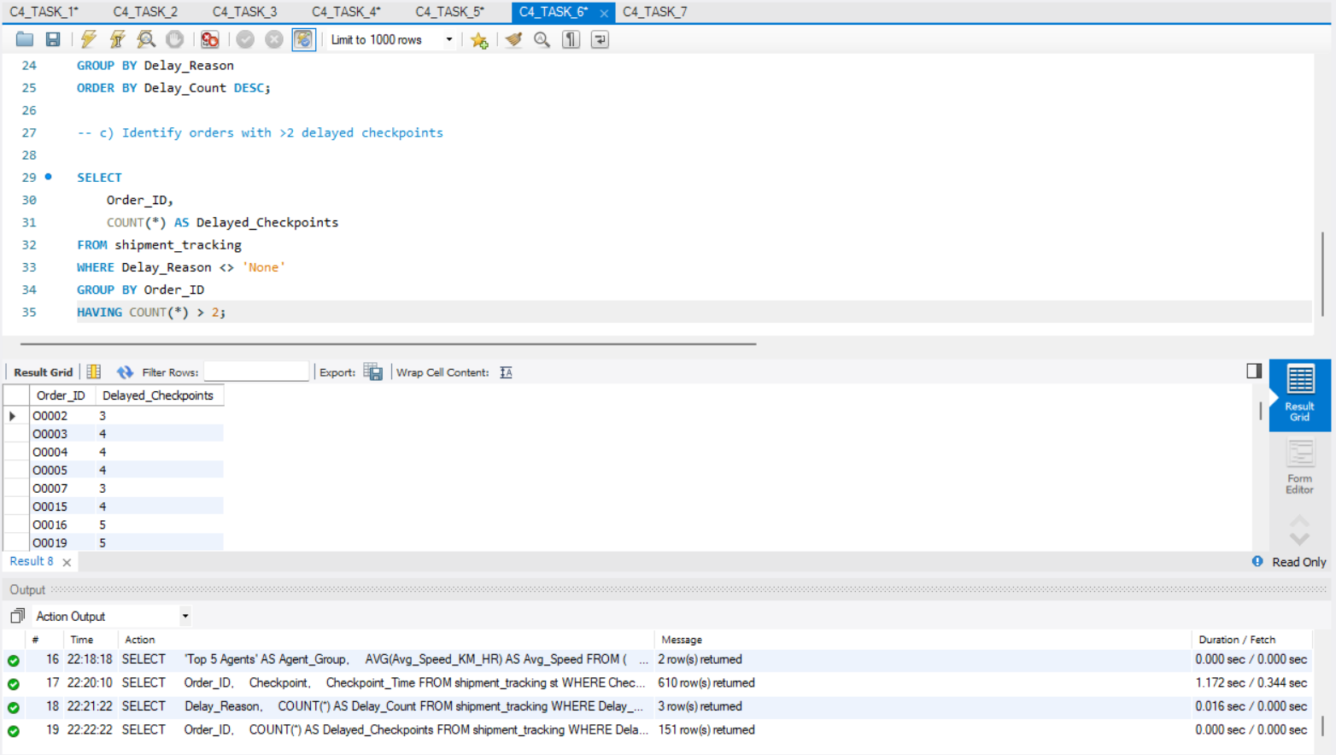
6. c) Identify orders with >2 delayed checkpoints

Slide 18
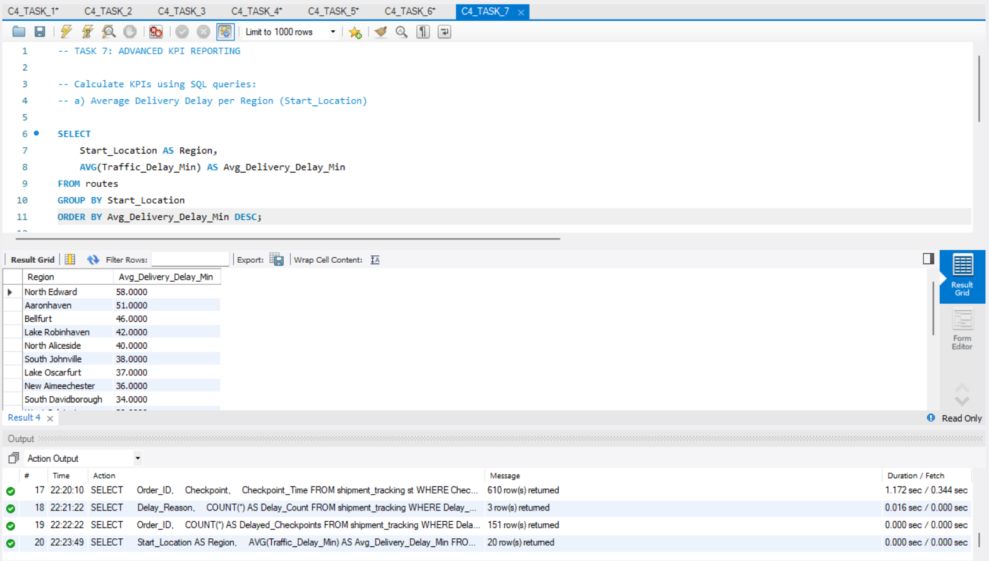
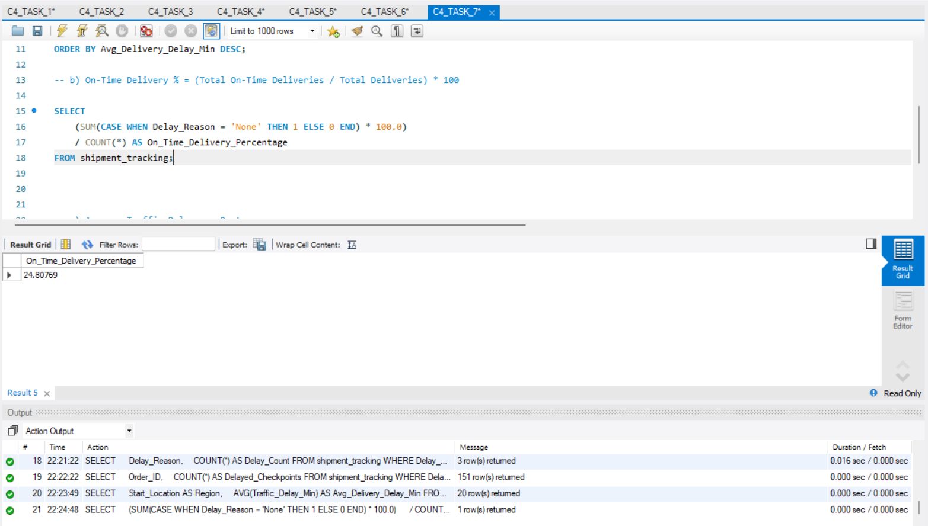
Task 7: Advanced KPI Reporting
7. b) On-Time Delivery % = (Total On-Time Deliveries / Total Deliveries) * 100.
7. a) Average Delivery Delay per Region (start_location)

Slide 19
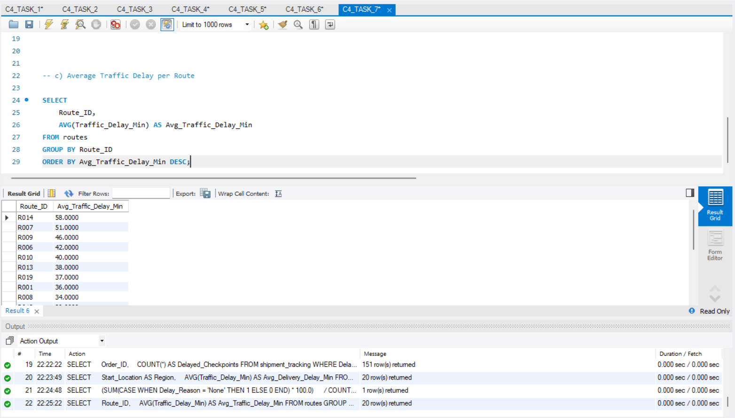
7. c) Average Traffic Delay per Route

Slide 20
Project Summary
This project analyzed logistics and delivery operations using SQL by working with datasets such as orders, routes, warehouses, delivery agents, and shipment tracking. Key performance metrics like On-Time Delivery %, average delays by region, traffic delays per route, and agent performance were calculated to evaluate delivery efficiency.
The analysis revealed that traffic conditions, route efficiency, and warehouse operations significantly impact delivery performance. By identifying high-delay routes, common delay reasons, and lower-performing agents, the project demonstrates how SQL-based data analysis can help logistics companies detect bottlenecks and improve operational decisions.
Overall, this project shows how data analytics can support better route planning, performance monitoring, and supply chain optimization.

Slide 21
THE LINK OF MY VIDEO:
https://www.loom.com/share/f1fc230fa2964d129a49de1576034a8b
THANK YOU!
THANK YOU!

